Slide 1

Introduction to Object Tracking
Marko Knežević

Slide 2


ABOUT
WHO WE
ARE.
FOUNDATION
2010
GAMES
Top Eleven
Golden Boot
HQ
Belgrade, Serbia
CREW
170 People,
21 Nationalities

Slide 3

Deep Learning for gameplay improvements
Artificial Intelligence for games
Computer Vision for video analysis
Machine Learning Team
SLIDE 3 / 37
Notes:
You go from intuitions like “my alarm not going off causes me to be late” to intuitions like “my alarm not going off causes me to be much more likely to be late”.

Slide 4
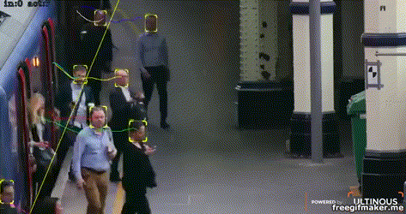
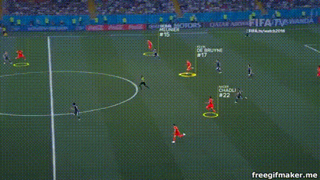
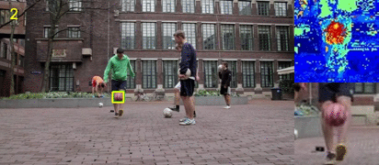
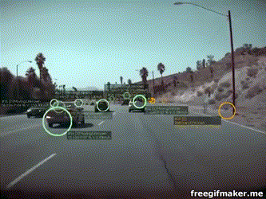
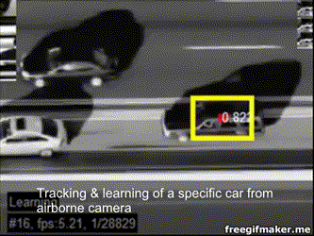
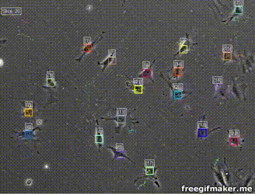
Credits to: Ultinous
Credits to: SPORTLOGiQ
Credits to: H. Possegger
Credits to: Tesla
Applications of Object Tracking
SLIDE 4 / 37
Credits to: Z. Kalal
Credits to: CellTracker
Notes:
You go from intuitions like “my alarm not going off causes me to be late” to intuitions like “my alarm not going off causes me to be much more likely to be late”.

Slide 5

Problem Statement
Challenges
Object representation
Single target tracking
TALK OUTLINE
Multi target tracking
Summary
Conclusion of the talk, References, Competitions, Questions
SLIDE 5 / 37

Slide 6
Input: target
Objective: Estimate target state over time
State:
  Position
  Appearance
  Shape
  Velocity, etc.
Choice:
  Object representation
  Similarity measure
  Searching process
Problem Statement
SLIDE 6 / 37
Notes:
You go from intuitions like “my alarm not going off causes me to be late” to intuitions like “my alarm not going off causes me to be much more likely to be late”.

Slide 7
Problem Statement
Challenges
Object representation
Single target tracking
TALK OUTLINE
Multi target tracking
Summary
Conclusion of the talk, References, Competitions, Questions
SLIDE 7 / 37

Slide 8
Variations due to geometric changes
(pose, articulation, scale)
Variations due to photometric factors
(illumination, appearance)
Occlusions
Non-linear motion
Very limited resolution, blurry
(standard recognition might fail)
Similar object in the scene
Challenges
SLIDE 8 / 37
Notes:
You go from intuitions like “my alarm not going off causes me to be late” to intuitions like “my alarm not going off causes me to be much more likely to be late”.

Slide 9
Track initiation & termination
Occlusion handling
Merging / switching
Drifting due to wrong update of the target model
Algorithms common issues
SLIDE 9 / 37
Notes:
You go from intuitions like “my alarm not going off causes me to be late” to intuitions like “my alarm not going off causes me to be much more likely to be late”.

Slide 10
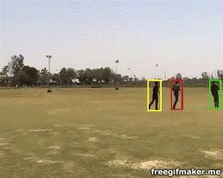
Occlusion example
SLIDE 10 / 37
Credits to: Prithwijit Guha
Notes:
You go from intuitions like “my alarm not going off causes me to be late” to intuitions like “my alarm not going off causes me to be much more likely to be late”.

Slide 11

ID Switch
SLIDE 11 / 37
Credits to: Prithwijit Guha
Notes:
You go from intuitions like “my alarm not going off causes me to be late” to intuitions like “my alarm not going off causes me to be much more likely to be late”.

Slide 12
Problem Statement
Challenges
Object representation
Single target tracking
TALK OUTLINE
Multi target tracking
Summary
Conclusion of the talk, References, Competitions, Questions
SLIDE 12 / 37

Slide 13
Descriptive enough to disambiguate target VS background
Flexible enough to cope with:
  Scale
  Pose
  Illumination
  Partial occlusions
Object approximation:
  Segmentation, Bounding ellipse, Position only
Object representation
SLIDE 13 / 37
Notes:
You go from intuitions like “my alarm not going off causes me to be late” to intuitions like “my alarm not going off causes me to be much more likely to be late”.

Slide 14
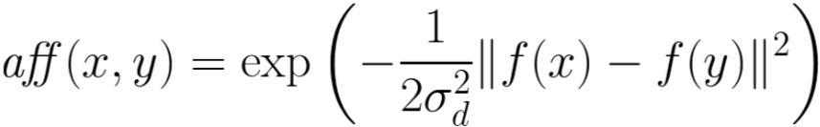
Goal: Measure affinity
In general:
Examples:
  Distance: f(x) = location(x)
  Intensity: f(x) = intensity(x)
  Color: f(x) = color(x)
  Texture: f(x) = filterbank(x)
Object representation
SLIDE 14 / 37
Notes:
You go from intuitions like “my alarm not going off causes me to be late” to intuitions like “my alarm not going off causes me to be much more likely to be late”.

Slide 15
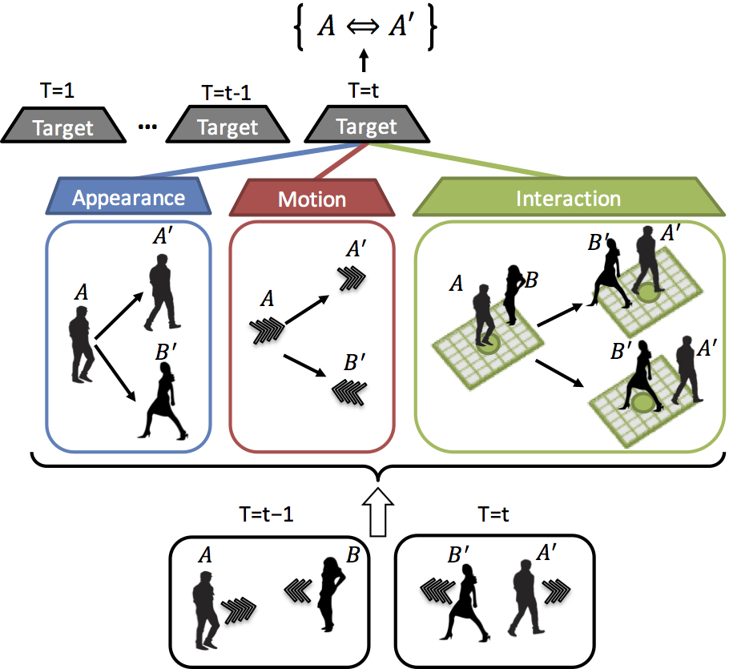
Object representation
“Tracking the Untrackable: Learning to Track Multiple Cues with Long-Term Dependencies”, A. Sadeghian, et. al.
SLIDE 15 / 37
Notes:
Typically to extract features, you can use the top layer of the network before the output. The intuition is that these features are linearly separable because the top layer is just a logistic regression.
For GANs, you can use the features from the discriminator. These features are supposed to give a probability if the input came from the training dataset, "real images". In Radford's DCGAN paper, they use all the convolutional layers of the discriminator and run a max pooling layer extract features for CIFAR-10.
Typically to extract features, you can use the top layer of the network before the output. The intuition is that these features are linearly separable because the top layer is just a logistic regression.
For GANs, you can use the features from the discriminator. These features are supposed to give a probability if the input came from the training dataset, "real images". In Radford's DCGAN paper, they use all the convolutional layers of the discriminator and run a max pooling layer extract features for CIFAR-10.

Slide 16
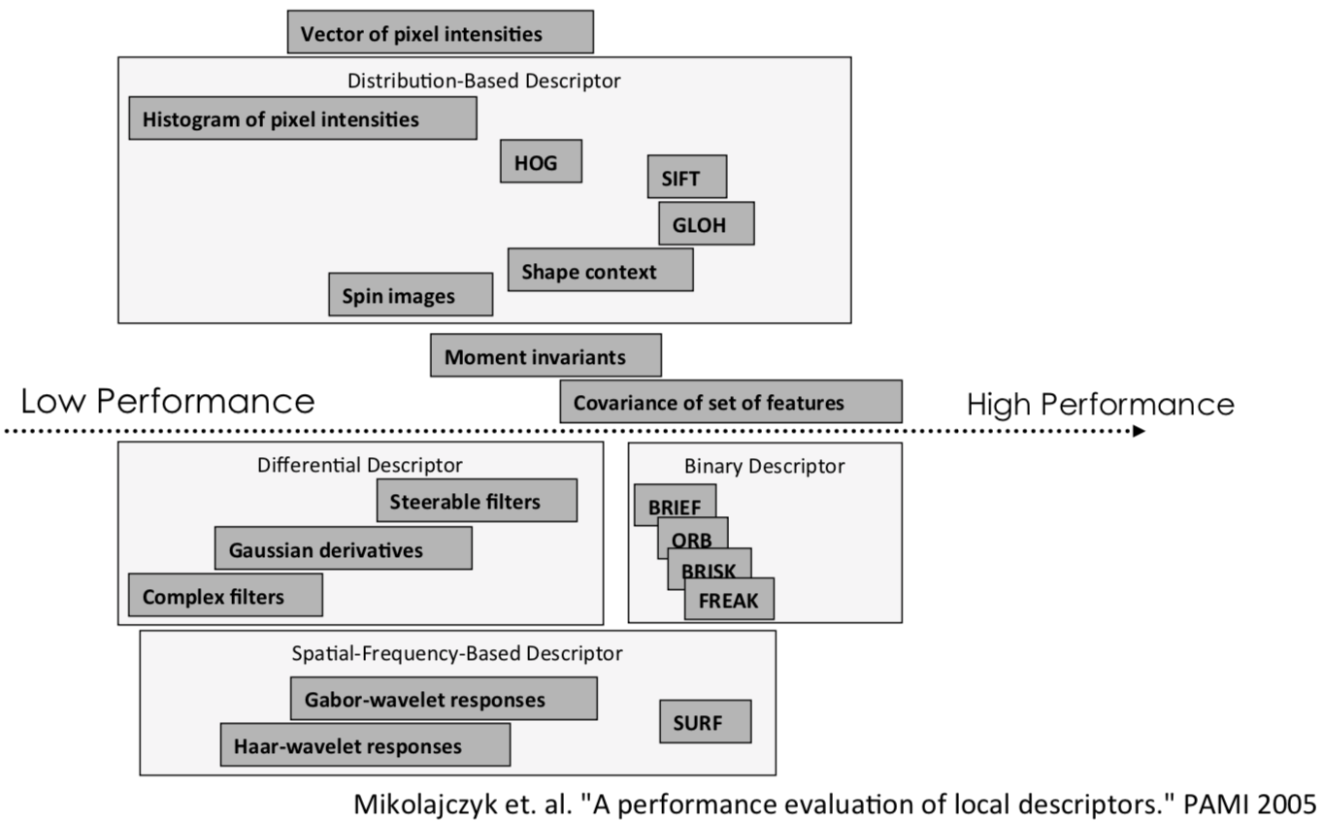
Object representation
low-level features
SLIDE 16 / 37

Slide 17
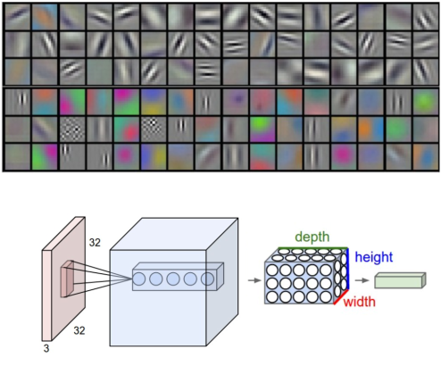
Recent trends:
  CNN features
  Encoders
  GAN
Object representation
features
SLIDE 17 / 37
Notes:
Typically to extract features, you can use the top layer of the network before the output. The intuition is that these features are linearly separable because the top layer is just a logistic regression.
For GANs, you can use the features from the discriminator. These features are supposed to give a probability if the input came from the training dataset, "real images". In Radford's DCGAN paper, they use all the convolutional layers of the discriminator and run a max pooling layer extract features for CIFAR-10.
Typically to extract features, you can use the top layer of the network before the output. The intuition is that these features are linearly separable because the top layer is just a logistic regression.
For GANs, you can use the features from the discriminator. These features are supposed to give a probability if the input came from the training dataset, "real images". In Radford's DCGAN paper, they use all the convolutional layers of the discriminator and run a max pooling layer extract features for CIFAR-10.

Slide 18
Problem Statement
Challenges
Object representation
Single target tracking
TALK OUTLINE
Multi target tracking
Summary
Conclusion of the talk, References, Competitions, Questions
SLIDE 18 / 37

Slide 19
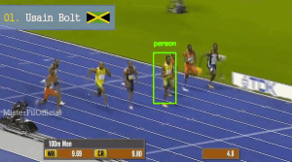
Formulation:
  Input: bounding box at starting frame
  Output: next bounding boxes across the next frames
Single target tracking
SLIDE 19 / 37
Notes:
Typically to extract features, you can use the top layer of the network before the output. The intuition is that these features are linearly separable because the top layer is just a logistic regression.
For GANs, you can use the features from the discriminator. These features are supposed to give a probability if the input came from the training dataset, "real images". In Radford's DCGAN paper, they use all the convolutional layers of the discriminator and run a max pooling layer extract features for CIFAR-10.
Typically to extract features, you can use the top layer of the network before the output. The intuition is that these features are linearly separable because the top layer is just a logistic regression.
For GANs, you can use the features from the discriminator. These features are supposed to give a probability if the input came from the training dataset, "real images". In Radford's DCGAN paper, they use all the convolutional layers of the discriminator and run a max pooling layer extract features for CIFAR-10.

Slide 20
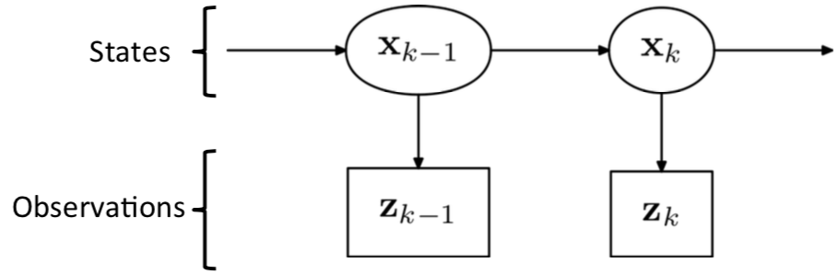
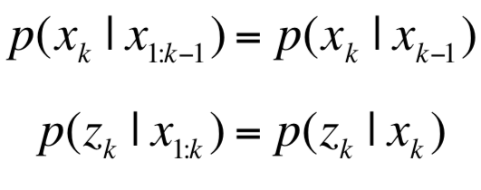
Probabilistic tracking
  Tracking as a Bayesian network
  Hidden Markov Model
  Markov assumptions
Single target tracking
SLIDE 20 / 37
Notes:
Typically to extract features, you can use the top layer of the network before the output. The intuition is that these features are linearly separable because the top layer is just a logistic regression.
For GANs, you can use the features from the discriminator. These features are supposed to give a probability if the input came from the training dataset, "real images". In Radford's DCGAN paper, they use all the convolutional layers of the discriminator and run a max pooling layer extract features for CIFAR-10.
Typically to extract features, you can use the top layer of the network before the output. The intuition is that these features are linearly separable because the top layer is just a logistic regression.
For GANs, you can use the features from the discriminator. These features are supposed to give a probability if the input came from the training dataset, "real images". In Radford's DCGAN paper, they use all the convolutional layers of the discriminator and run a max pooling layer extract features for CIFAR-10.

Slide 21
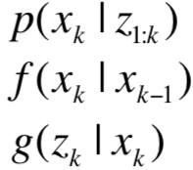
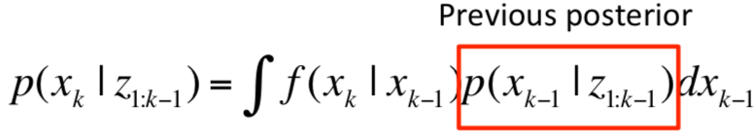
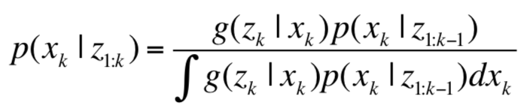
Probabilistic tracking
  Recursive Bayes filters
  Find posterior
  State eq. (motion dynamics)
  Observation eq. (image)
Prediction
Update
Single target tracking
SLIDE 21 / 37
Notes:
Typically to extract features, you can use the top layer of the network before the output. The intuition is that these features are linearly separable because the top layer is just a logistic regression.
For GANs, you can use the features from the discriminator. These features are supposed to give a probability if the input came from the training dataset, "real images". In Radford's DCGAN paper, they use all the convolutional layers of the discriminator and run a max pooling layer extract features for CIFAR-10.
Typically to extract features, you can use the top layer of the network before the output. The intuition is that these features are linearly separable because the top layer is just a logistic regression.
For GANs, you can use the features from the discriminator. These features are supposed to give a probability if the input came from the training dataset, "real images". In Radford's DCGAN paper, they use all the convolutional layers of the discriminator and run a max pooling layer extract features for CIFAR-10.

Slide 22
Solving Bayes Equations
  Gaussian & Linear
    Kalman filter
  Gaussian non-linear
    Extended Kalman filter
  Non-Gaussian non-linear
    Monte Carlo methods
  Hill-climbing on posterior
    Mean-shift
Kernel-based tracking
Mean-shift
Single target tracking
SLIDE 22 / 37
Notes:
Typically to extract features, you can use the top layer of the network before the output. The intuition is that these features are linearly separable because the top layer is just a logistic regression.
For GANs, you can use the features from the discriminator. These features are supposed to give a probability if the input came from the training dataset, "real images". In Radford's DCGAN paper, they use all the convolutional layers of the discriminator and run a max pooling layer extract features for CIFAR-10.
Typically to extract features, you can use the top layer of the network before the output. The intuition is that these features are linearly separable because the top layer is just a logistic regression.
For GANs, you can use the features from the discriminator. These features are supposed to give a probability if the input came from the training dataset, "real images". In Radford's DCGAN paper, they use all the convolutional layers of the discriminator and run a max pooling layer extract features for CIFAR-10.

Slide 23
Problem Statement
Challenges
Object representation
Single target tracking
TALK OUTLINE
Multi target tracking
Summary
Conclusion of the talk, References, Competitions, Questions
SLIDE 23 / 37

Slide 24
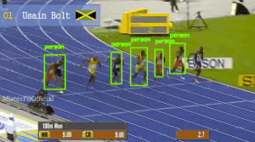
Formulation
  Input: a set of detections
  Output: state (id) for each detections
Multi-target tracking
SLIDE 24 / 37
Notes:
Typically to extract features, you can use the top layer of the network before the output. The intuition is that these features are linearly separable because the top layer is just a logistic regression.
For GANs, you can use the features from the discriminator. These features are supposed to give a probability if the input came from the training dataset, "real images". In Radford's DCGAN paper, they use all the convolutional layers of the discriminator and run a max pooling layer extract features for CIFAR-10.
Typically to extract features, you can use the top layer of the network before the output. The intuition is that these features are linearly separable because the top layer is just a logistic regression.
For GANs, you can use the features from the discriminator. These features are supposed to give a probability if the input came from the training dataset, "real images". In Radford's DCGAN paper, they use all the convolutional layers of the discriminator and run a max pooling layer extract features for CIFAR-10.

Slide 25
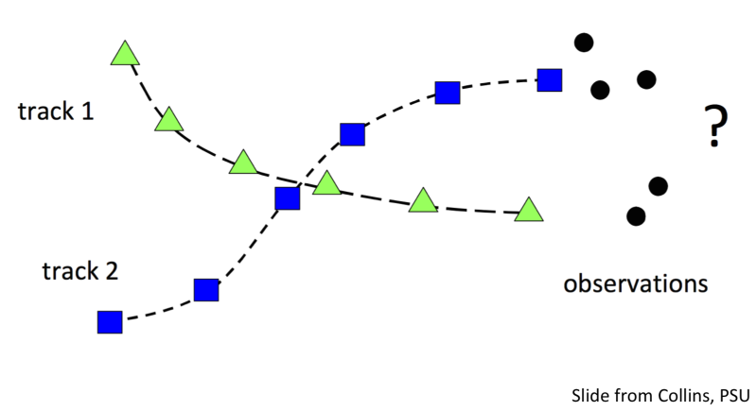
Multi-target tracking
SLIDE 25 / 37
Notes:
Typically to extract features, you can use the top layer of the network before the output. The intuition is that these features are linearly separable because the top layer is just a logistic regression.
For GANs, you can use the features from the discriminator. These features are supposed to give a probability if the input came from the training dataset, "real images". In Radford's DCGAN paper, they use all the convolutional layers of the discriminator and run a max pooling layer extract features for CIFAR-10.
Typically to extract features, you can use the top layer of the network before the output. The intuition is that these features are linearly separable because the top layer is just a logistic regression.
For GANs, you can use the features from the discriminator. These features are supposed to give a probability if the input came from the training dataset, "real images". In Radford's DCGAN paper, they use all the convolutional layers of the discriminator and run a max pooling layer extract features for CIFAR-10.

Slide 26
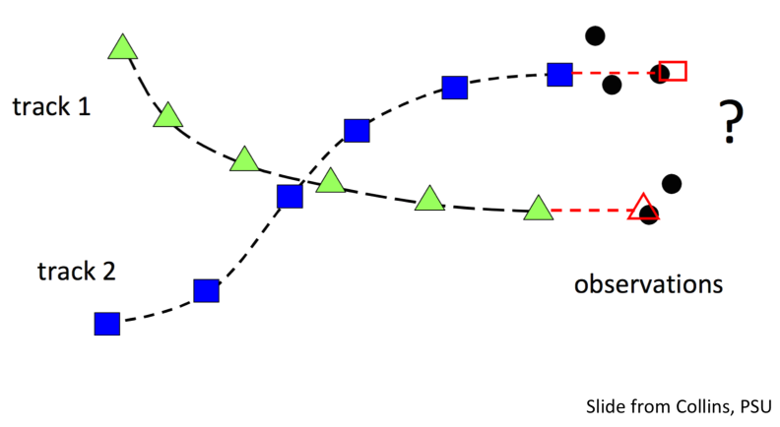
Multi-target tracking
SLIDE 26 / 37
Notes:
Typically to extract features, you can use the top layer of the network before the output. The intuition is that these features are linearly separable because the top layer is just a logistic regression.
For GANs, you can use the features from the discriminator. These features are supposed to give a probability if the input came from the training dataset, "real images". In Radford's DCGAN paper, they use all the convolutional layers of the discriminator and run a max pooling layer extract features for CIFAR-10.
Typically to extract features, you can use the top layer of the network before the output. The intuition is that these features are linearly separable because the top layer is just a logistic regression.
For GANs, you can use the features from the discriminator. These features are supposed to give a probability if the input came from the training dataset, "real images". In Radford's DCGAN paper, they use all the convolutional layers of the discriminator and run a max pooling layer extract features for CIFAR-10.

Slide 27
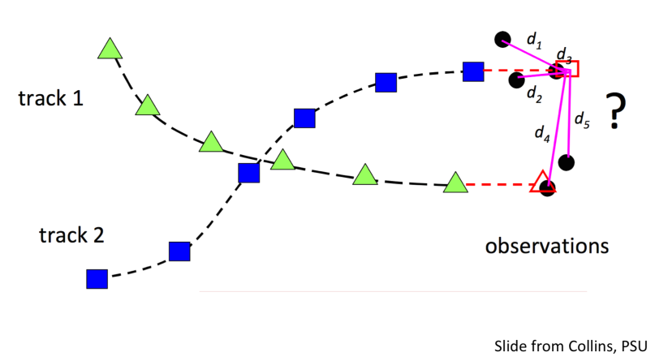
Multi-target tracking
SLIDE 27 / 37
Notes:
Typically to extract features, you can use the top layer of the network before the output. The intuition is that these features are linearly separable because the top layer is just a logistic regression.
For GANs, you can use the features from the discriminator. These features are supposed to give a probability if the input came from the training dataset, "real images". In Radford's DCGAN paper, they use all the convolutional layers of the discriminator and run a max pooling layer extract features for CIFAR-10.
Typically to extract features, you can use the top layer of the network before the output. The intuition is that these features are linearly separable because the top layer is just a logistic regression.
For GANs, you can use the features from the discriminator. These features are supposed to give a probability if the input came from the training dataset, "real images". In Radford's DCGAN paper, they use all the convolutional layers of the discriminator and run a max pooling layer extract features for CIFAR-10.

Slide 28
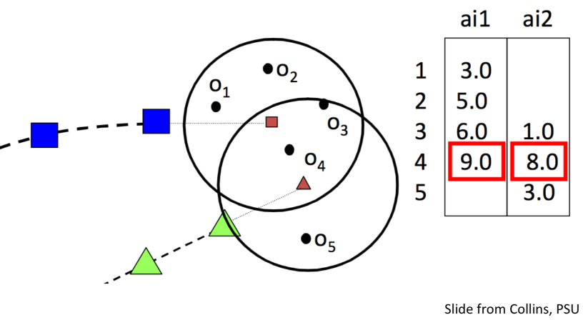
Multi-target tracking
SLIDE 28 / 37
Notes:
Typically to extract features, you can use the top layer of the network before the output. The intuition is that these features are linearly separable because the top layer is just a logistic regression.
For GANs, you can use the features from the discriminator. These features are supposed to give a probability if the input came from the training dataset, "real images". In Radford's DCGAN paper, they use all the convolutional layers of the discriminator and run a max pooling layer extract features for CIFAR-10.
Typically to extract features, you can use the top layer of the network before the output. The intuition is that these features are linearly separable because the top layer is just a logistic regression.
For GANs, you can use the features from the discriminator. These features are supposed to give a probability if the input came from the training dataset, "real images". In Radford's DCGAN paper, they use all the convolutional layers of the discriminator and run a max pooling layer extract features for CIFAR-10.

Slide 29
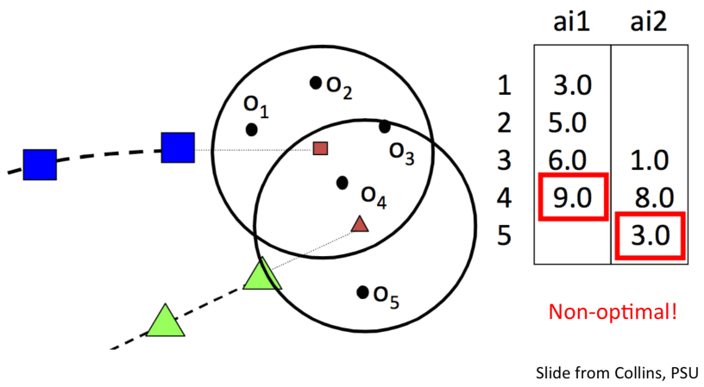
Multi-target tracking
SLIDE 29 / 37
Notes:
Typically to extract features, you can use the top layer of the network before the output. The intuition is that these features are linearly separable because the top layer is just a logistic regression.
For GANs, you can use the features from the discriminator. These features are supposed to give a probability if the input came from the training dataset, "real images". In Radford's DCGAN paper, they use all the convolutional layers of the discriminator and run a max pooling layer extract features for CIFAR-10.
Typically to extract features, you can use the top layer of the network before the output. The intuition is that these features are linearly separable because the top layer is just a logistic regression.
For GANs, you can use the features from the discriminator. These features are supposed to give a probability if the input came from the training dataset, "real images". In Radford's DCGAN paper, they use all the convolutional layers of the discriminator and run a max pooling layer extract features for CIFAR-10.

Slide 30
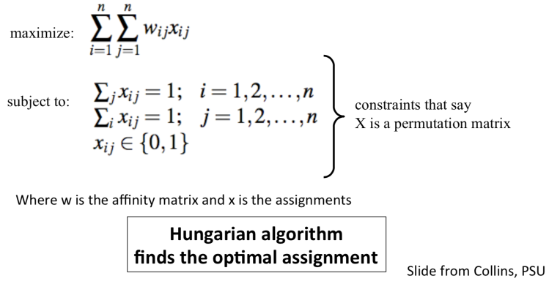
The permutation matrix ensures that we only match up one object from each row and from each column.
Linear Assignment Problem
SLIDE 30 / 37
Notes:
Typically to extract features, you can use the top layer of the network before the output. The intuition is that these features are linearly separable because the top layer is just a logistic regression.
For GANs, you can use the features from the discriminator. These features are supposed to give a probability if the input came from the training dataset, "real images". In Radford's DCGAN paper, they use all the convolutional layers of the discriminator and run a max pooling layer extract features for CIFAR-10.
Typically to extract features, you can use the top layer of the network before the output. The intuition is that these features are linearly separable because the top layer is just a logistic regression.
For GANs, you can use the features from the discriminator. These features are supposed to give a probability if the input came from the training dataset, "real images". In Radford's DCGAN paper, they use all the convolutional layers of the discriminator and run a max pooling layer extract features for CIFAR-10.

Slide 31
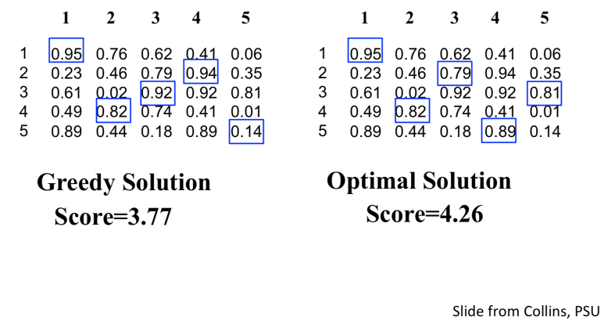
Linear Assignment Problem
SLIDE 31 / 37
Notes:
Typically to extract features, you can use the top layer of the network before the output. The intuition is that these features are linearly separable because the top layer is just a logistic regression.
For GANs, you can use the features from the discriminator. These features are supposed to give a probability if the input came from the training dataset, "real images". In Radford's DCGAN paper, they use all the convolutional layers of the discriminator and run a max pooling layer extract features for CIFAR-10.
Typically to extract features, you can use the top layer of the network before the output. The intuition is that these features are linearly separable because the top layer is just a logistic regression.
For GANs, you can use the features from the discriminator. These features are supposed to give a probability if the input came from the training dataset, "real images". In Radford's DCGAN paper, they use all the convolutional layers of the discriminator and run a max pooling layer extract features for CIFAR-10.

Slide 32
Hungarian Algorithm (Kuhn-Munkres)
  O(n³)
  Pro: optimal single frame assignment
  Con: Not optimal for multiple frames
Example 1 Example 2
40 | 60 | 15
25 | 30 | 45
55 | 30 | 25
30 | 25 | 10
15 | 10 | 20
25 | 20 | 15
Linear Assignment Problem
SLIDE 32 / 37
Notes:
Typically to extract features, you can use the top layer of the network before the output. The intuition is that these features are linearly separable because the top layer is just a logistic regression.
For GANs, you can use the features from the discriminator. These features are supposed to give a probability if the input came from the training dataset, "real images". In Radford's DCGAN paper, they use all the convolutional layers of the discriminator and run a max pooling layer extract features for CIFAR-10.
Typically to extract features, you can use the top layer of the network before the output. The intuition is that these features are linearly separable because the top layer is just a logistic regression.
For GANs, you can use the features from the discriminator. These features are supposed to give a probability if the input came from the training dataset, "real images". In Radford's DCGAN paper, they use all the convolutional layers of the discriminator and run a max pooling layer extract features for CIFAR-10.

Slide 33
Problem Statement
Challenges
Object representation
Single target tracking
TALK OUTLINE
Multi target tracking
Summary
Conclusion of the talk, References, Competitions, Questions
SLIDE 33 / 37

Slide 34
“Visual object tracking” is not a single problem, but a series of problems.
Speed is very important for real world applications
Best-performing methods combine various features
CNN methods outperform others but require GPU
Summary
SLIDE 34 / 37
Notes:
Typically to extract features, you can use the top layer of the network before the output. The intuition is that these features are linearly separable because the top layer is just a logistic regression.
For GANs, you can use the features from the discriminator. These features are supposed to give a probability if the input came from the training dataset, "real images". In Radford's DCGAN paper, they use all the convolutional layers of the discriminator and run a max pooling layer extract features for CIFAR-10.
Typically to extract features, you can use the top layer of the network before the output. The intuition is that these features are linearly separable because the top layer is just a logistic regression.
For GANs, you can use the features from the discriminator. These features are supposed to give a probability if the input came from the training dataset, "real images". In Radford's DCGAN paper, they use all the convolutional layers of the discriminator and run a max pooling layer extract features for CIFAR-10.

Slide 35
MOTChallenge: The Multiple Object Tracking Benchmark
  https://motchallenge.net/
Visual Object Tracking Challenge
  http://www.votchallenge.net/
Vision Meets Drones: A Challenge
  http://aiskyeye.com/
Competitions and Data Sets
SLIDE 35 / 37
Notes:
Typically to extract features, you can use the top layer of the network before the output. The intuition is that these features are linearly separable because the top layer is just a logistic regression.
For GANs, you can use the features from the discriminator. These features are supposed to give a probability if the input came from the training dataset, "real images". In Radford's DCGAN paper, they use all the convolutional layers of the discriminator and run a max pooling layer extract features for CIFAR-10.
Typically to extract features, you can use the top layer of the network before the output. The intuition is that these features are linearly separable because the top layer is just a logistic regression.
For GANs, you can use the features from the discriminator. These features are supposed to give a probability if the input came from the training dataset, "real images". In Radford's DCGAN paper, they use all the convolutional layers of the discriminator and run a max pooling layer extract features for CIFAR-10.

Slide 36
“Fusion of Head and Full-Body Detectors for Multi-Object Tracking”
“Tracking The Untrackable: Learning To Track Multiple Cues with Long-Term Dependencies”
“Simple Online and Realtime Tracking with a Deep Association Metric”
“Tracking of Tennis Ball in Tennis Serving Videos Using Particle Filtering and Segmentation”
“Multi-object Tracking with Combined Constraints and Geometry Verification”
References
SLIDE 36 / 37
Notes:
Typically to extract features, you can use the top layer of the network before the output. The intuition is that these features are linearly separable because the top layer is just a logistic regression.
For GANs, you can use the features from the discriminator. These features are supposed to give a probability if the input came from the training dataset, "real images". In Radford's DCGAN paper, they use all the convolutional layers of the discriminator and run a max pooling layer extract features for CIFAR-10.
Typically to extract features, you can use the top layer of the network before the output. The intuition is that these features are linearly separable because the top layer is just a logistic regression.
For GANs, you can use the features from the discriminator. These features are supposed to give a probability if the input came from the training dataset, "real images". In Radford's DCGAN paper, they use all the convolutional layers of the discriminator and run a max pooling layer extract features for CIFAR-10.

Slide 37

SLIDE 37

